Slide 1
2CS304 – Digital Communications
Tutorial 0
Introduction and Pre-requisites

Slide 2
Outline
Digital Communications
Signals
Bits and Bytes
Characteristics of Signals
MCQs

Slide 3
Digital Communications
Process of using computing and communication technologies to transfer data from one place to another and vice-versa
Enables movement of electronic and digital data between two or more nodes, regardless of geographical location, technological medium or data contents

Slide 4
Data Vs. Information
Data is information that has been translated into a form that is efficient for movement or processing
In the contemporary world, involving computers and transmission media, data is information converted into binary digital form
Data with meaning for its receiver is said to be information

Slide 5
Data Vs. Information (Examples)
Example of Data:
Nirma, University, Vaishnodevi, Circle, SG, Higway, AHMEDABAD, 382481, 02717 241 900
Example of information:
Nirma University,
Vaishnodevi Circle,
SG Higway,
AHMEDABAD-382481
02717- 241 900

Slide 6
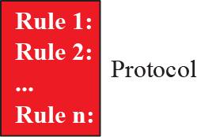
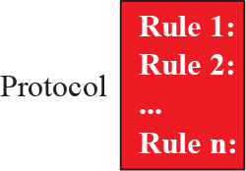



Components of Communication

Slide 7
Signal
No file, audio, video or audio-visual information can be directly transmitted
It first needs to be converted into an electronic form called ‘Signal’
The devices operate in the binary system i.e. a combination of 1s and 0s only (generally 1 denotes ‘on’ or ‘high’ and 0 denotes ‘off ’ or ‘low’)
Data is made transmission ready i.e. into a binary form called a ‘Signal

Slide 8
Types of Signals
Analog Signals
Analog signals can have an infinite number of values in a range
Digital Signals
Digital signals can have only a limited number of values
These values are discrete in nature

Slide 9
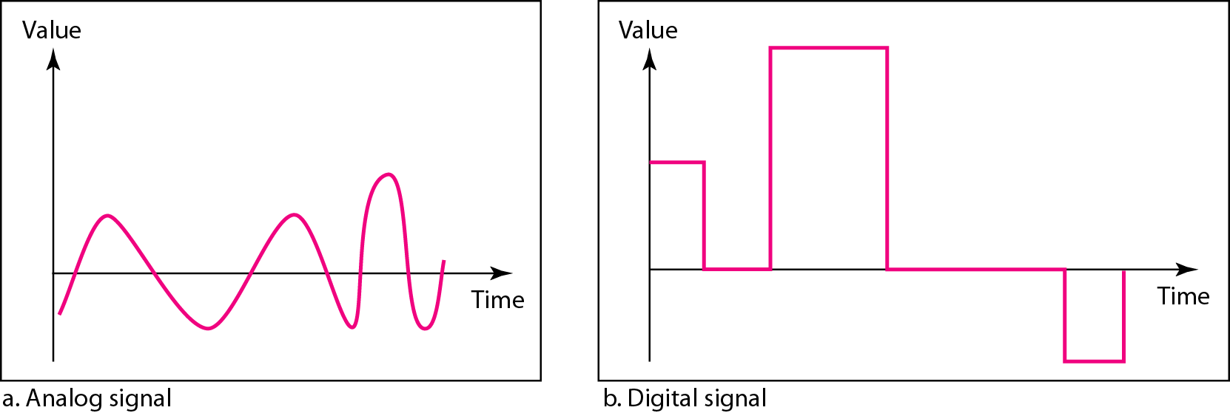
Analog Vs. Digital Signals

Slide 10
Bits and Bytes
Bit means Binary Digit
Half byte = 1 nibble = 4 bits
1 byte = 8 bits
A combination of 16 bits are called word

Slide 11
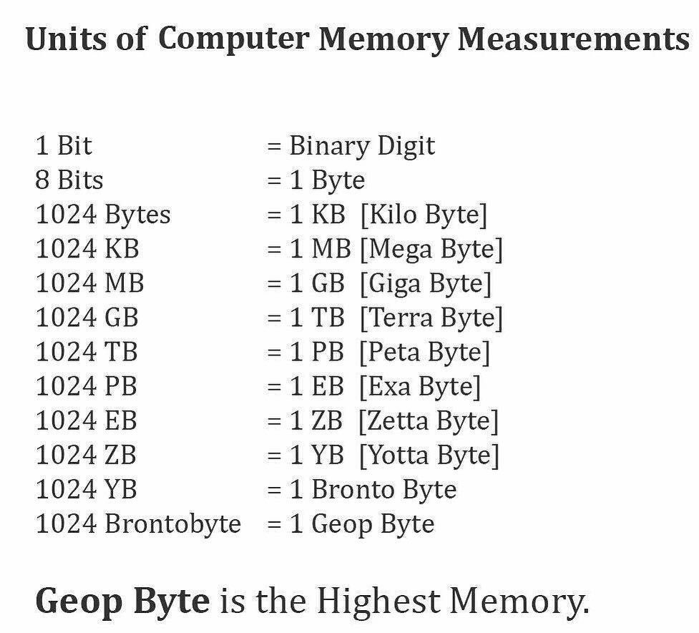

Slide 12
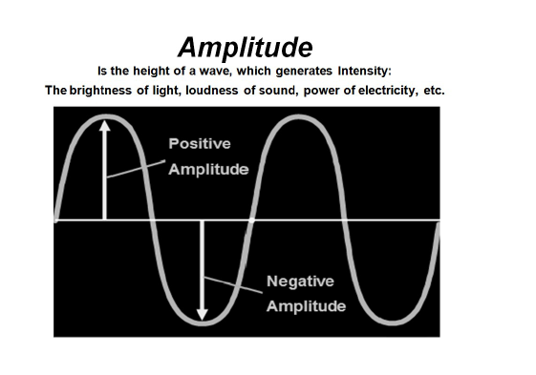
Example
Amplitude
The maximum displacement of a particle from its mean position is an‘ Amplitude‘
Unit - Volt
Consider a sinusoidal wave transmitting energy in space with the wave passing through a series of particles which oscillate about a mean position and transmit the energy

Slide 13
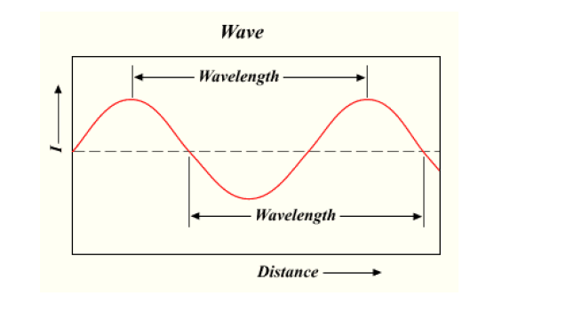
Wavelength
The wavelength is the distance between two particles having the same amount of displacement and both are in phase with each other

Slide 14
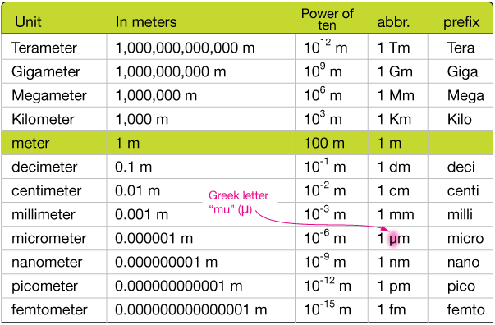
Wavelength (Units)

Slide 15
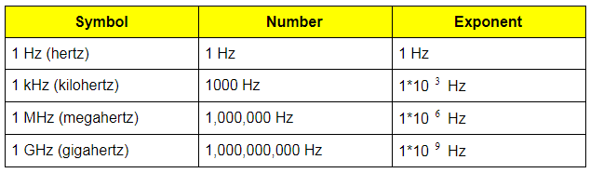
Frequency
The frequency of a wave is the number of waves passing a point in space per unit time. It is basically the reciprocal of the time period required by a wave to cover a unit distance
Units

Slide 16
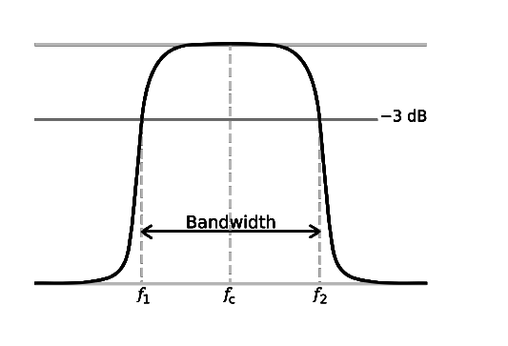
Bandwidth
The bandwidth of a signal is the difference between the highest and the lowest frequencies carried by the signal

Slide 17
Related Questionnaire
What unit of storage is used to represent 10⁹ bytes? A. Kilobyte B. Terabyte C. Megabyte D. Gigabyte

Slide 18
Related Questionnaire
Bit is the short form for? A. Binary digit B. Digital byte C. Binary unit D. Binary system

Slide 19
Related Questionnaire
A group of bits used to represent a symbol is called a ____________ A. byte B. memory C. nibble
D. code

Slide 20
Related Questionnaire (High Order Thinking Skills)
Suppose you are to set up a network in your organization. Please assume the number of employees, various cadres (categories of users) and their related roles. Now note down the following in your notebook:
How many computers would you require?
How many servers (high end machines) do you require?
How do you interconnect various devices and tools?
Identify various tools to draw the network diagram and draw a sample network diagram.
Prepare a sample IT Policy for your organization.

Slide 21
Thank You!!!
End of Tutorial 0

